Slide 1
React.js, developed by Facebook, is a popular JavaScript library for building user interfaces, particularly single-page applications. It allows developers to create reusable UI components, leading to more efficient and manageable codebases. React's virtual DOM enhances performance by updating only the parts of the DOM that have changed. React's declarative nature makes it easier to reason about your application, and its component-based architecture encourages modular and reusable code. React has a large community and ecosystem, including tools like React Developer Tools, libraries like Redux for state management, and frameworks like Next.js for server-side rendering.
Introduction to React.js

Slide 2
Setting Up React Environment
Setting up a React development environment involves using tools like Node.js, npm (or Yarn), and create-react-app. First, install Node.js to get npm. Then, use create-react-app by running npx create-react-app my-app to scaffold a new React project with a pre-configured build setup. This tool simplifies initial setup and includes Webpack, Babel, and a development server. After creating the app, navigate to the project directory (cd my-app) and start the development server with npm start. This setup provides a local server with hot reloading, allowing for immediate feedback during development.

Slide 3
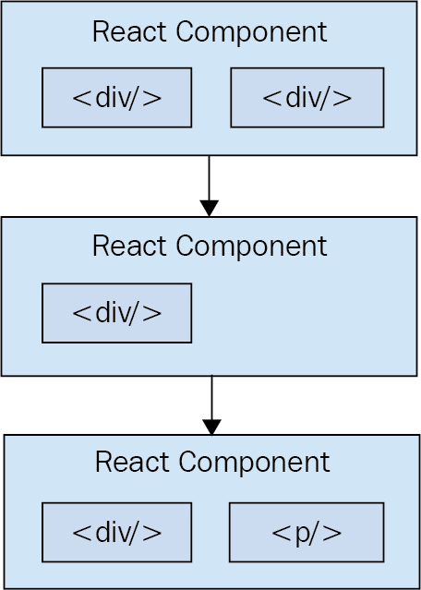
React Components
Components are the building blocks of React applications. They can be functional (stateless) or class-based (stateful). Functional components are simple JavaScript functions that return JSX, a syntax extension that looks like HTML. Class components extend React.Component and can manage state and lifecycle methods. Components accept props, short for properties, to pass data and functions between them. Reusability is a key feature, as components can be nested and composed to build complex UIs. Understanding components is fundamental to mastering React.

Slide 4
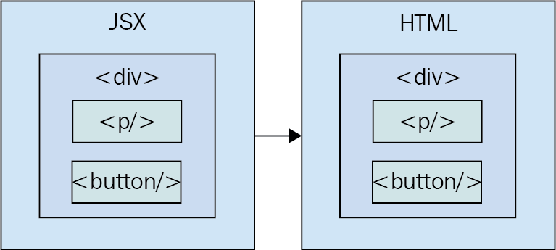
JSX
JavaScript XML
JSX stands for JavaScript XML, allowing developers to write HTML-like code within JavaScript. It makes code more readable and easier to write, especially when defining the structure of UI components. JSX elements are compiled to React.createElement calls, which create the virtual DOM elements. JSX supports embedding JavaScript expressions using curly braces {}, enabling dynamic content. Although optional, JSX is widely used due to its simplicity and expressiveness. React apps can be written without JSX, but it would require using plain JavaScript and React.createElement, making code less intuitive.

Slide 5
State and Props
State and props are core concepts in React. Props are read- only attributes passed from parent to child components, enabling data flow across the component hierarchy. State is an object managed within a component, allowing it to handle dynamic data and re-render when the state changes. In class components, state is initialized in the constructor, while functional components use the useState hook to manage state. Understanding how to properly use state and props is crucial for building interactive and dynamic React applications.

Slide 6
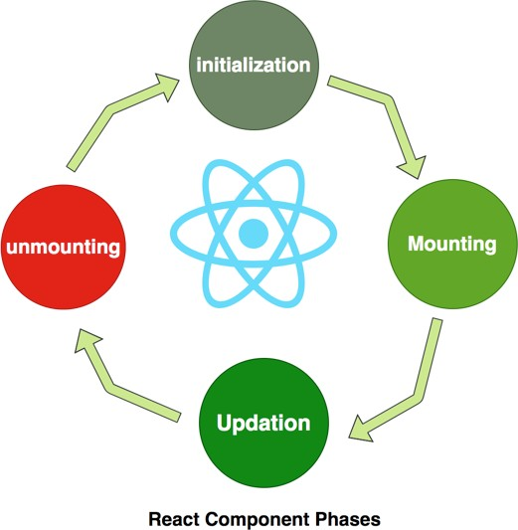
Lifecycle Methods
Lifecycle methods in class components allow developers to hook into specific points in a component's life: mounting, updating, and unmounting. Key methods include componentDidMount, componentDidUpdate, and componentWillUnmount. These methods enable tasks like fetching data, setting up subscriptions, and cleaning up resources. In functional components, lifecycle management is achieved using hooks such as useEffect, which can mimic lifecycle methods by running side effects based on dependencies. Lifecycle methods are essential for managing side effects and optimizing performance.

Slide 7
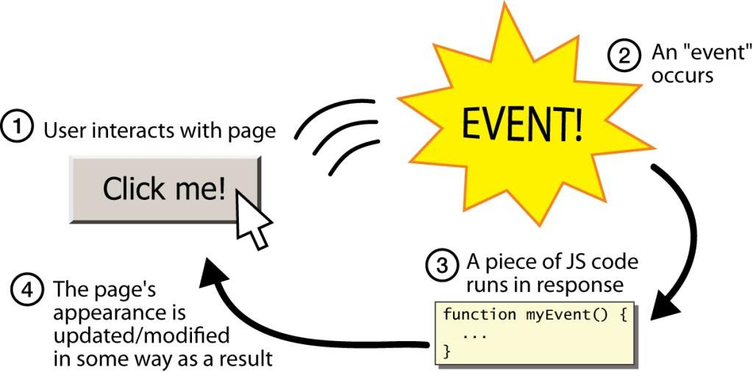
Handling Events
React handles events in a declarative way using synthetic events, which are cross- browser wrappers around native events. Event handlers are added directly in JSX using camelCase syntax, such as onClick. These handlers are typically functions that update state or perform other actions. Passing event handlers between components via props allows for flexible and reusable interaction logic. Understanding event handling in React is important for creating responsive and interactive user interfaces.

Slide 8
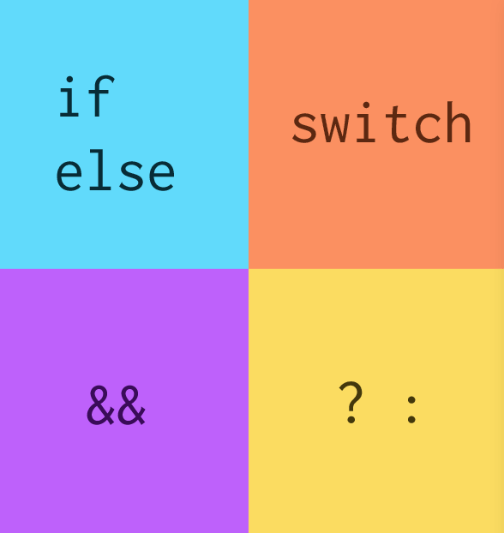
Conditional Rendering
Conditional rendering in React allows components to render different outputs based on conditions. This can be achieved using JavaScript conditional operators like if, else, and ternary operators within JSX. For example, {isLoggedIn ? <Dashboard /> :
<Login />} will render the Dashboard component if isLoggedIn is true, otherwise it renders the Login component. Conditional rendering enables the creation of dynamic and user-responsive UIs, allowing components to adapt based on user interactions or state changes.

Slide 9
Lists and Keys
Rendering lists in React involves using the map function to iterate over an array and return a list of elements. Each element must have a unique key prop to help React identify which items have changed, been added, or removed, optimizing the re- rendering process. Keys should be unique and stable, ideally using unique IDs from your data. Understanding how to efficiently render lists and assign keys is vital for performance and correct rendering of dynamic data in React applications.

Slide 10
Introduction to Hooks
Hooks, introduced in React 16.8, enable state and lifecycle features in functional components. The useState hook manages state, while the useEffect hook handles side effects like data fetching and subscriptions. Hooks simplify code, reduce the need for class components, and improve code reuse and readability. Other hooks include useContext for context API integration, useReducer for complex state logic, and custom hooks for shared logic. Mastering hooks is crucial for modern React development, offering a more functional approach to building components.

