Slide 1
Introduction to Node.js
Node.js is an open-source, cross-platform runtime environment that executes JavaScript on the server side. Created by Ryan Dahl in 2009, it's built on Google's V8 engine. Node.js's non-blocking, event-driven architecture makes it ideal for scalable, high-performance applications like chat servers and real-time web apps. Its ability to use JavaScript for both front and back-end development enhances code cohesion and efficiency, supported by a vibrant community and a rich ecosystem of tools.

Slide 2
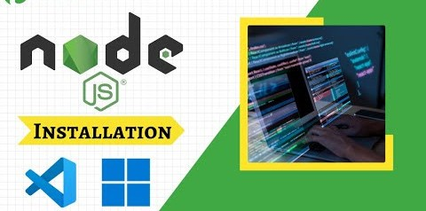
Installing Node.js
Installing Node.js varies by OS. On Windows, use the .msi installer from the Node.js website. macOS users can install via Homebrew (brew install node). Linux users often use package managers like apt or yum. Alternatively, Node Version Manager (nvm) allows managing multiple Node.js versions. Verify installation with node -v and npm -v. Keeping Node.js updated ensures access to the latest features and security patches.

Slide 3
Node.js Architecture
Node.js uses a single-threaded, non-blocking event loop and the V8 JavaScript engine for high performance. Its event-driven architecture allows handling multiple simultaneous connections efficiently, making it suitable for I/O-heavy applications. The event loop manages asynchronous operations like I/O tasks, continuing execution without waiting for tasks to complete. For CPU-intensive tasks, Node.js supports worker threads, utilizing multi-core systems while maintaining its asynchronous model.

Slide 4
Core Modules and NPM
Node.js includes core modules like http for web servers and fs for file system interactions. NPM (Node Package Manager) is a vast registry of open-source packag Install packages with npm install <package-name> and manage dependencies via package.json. NPM simplifies sharing and setting up project environments and allow publishing your own packages, fostering a collaborative development ecosystem.

Slide 5
Building a Simple Server
Creating a web server in Node.js involves the http module. Use require('http') to import it, and createServer to create a server instance. Define responses in a callback handling req and res, like setting headers with res.writeHead and sending data with res.end. Make the server listen on a port using listen. This setup serves as a foundation for more complex applications.

Slide 6
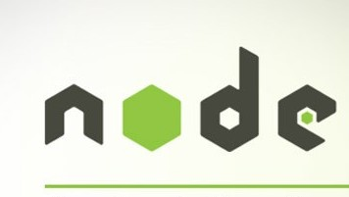
Asynchronous Programming in Node.js
Node.js handles asynchronous operations using callbacks, promises, and async/await Callbacks are functions executed after an async operation. Promises provide a cleane way to handle async results, using then and catch. Async/await, introduced in ES2017 allows writing asynchronous code that looks synchronous, improving readability and maintainability by pausing function execution until promises resolve.

Slide 7
Working with Express.js
Express.js is a minimal, flexible Node.js framework for building web applications. Install it with npm install express. Create an app instance and define routes using app.get for handling HTTP requests. Middleware functions, added with app.use, modify requests and responses, handling tasks like logging and authentication. Express's simplicity and middleware ecosystem make it ideal for RESTful APIs and web apps.

Slide 8
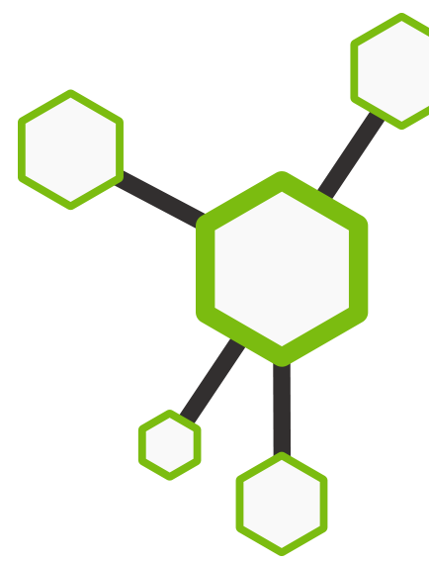
Connecting to a Database
Node.js integrates with databases like MongoDB and SQL. For MongoDB, use Mongoose (npm install mongoose) to define schemas and models, connecting with mongoose.connect. For SQL databases like MySQL, use libraries like mysql2 or ORMs like Sequelize (npm install sequelize).
Sequelize supports multiple SQL databases, mapping models to tables and simplifying database interactions within Node.js applications.

Slide 9
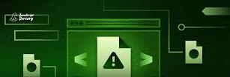
Error Handling and Debugging
Node.js handles errors using try-catch for synchronous code and various strategies for async code: callbacks check for errors, promises use catch, and async/await uses try- catch. Debugging tools include the Node.js debugger (--inspect flag) and integrated tools in editors like Visual Studio Code. Libraries like winston and morgan enhance logging, crucial for monitoring and troubleshooting applications.

Slide 10
Best Practices and Advanced Topics
Follow best practices like using environment variables, modular code structure, and security measures. Optimize performance with clustering (cluster module) and streams for efficient data handling. Explore microservices architecture for scalable applications. Node.js's event-driven model and robust ecosystem support these advanced topics, ensuring efficient, maintainable, and high-performance applications.

